Slide 1

DATABASES AND APPLICATIONS
SUBJECT CODE : UQ23CA653A
Samyukta D Kumta
Computer Applications

Slide 2

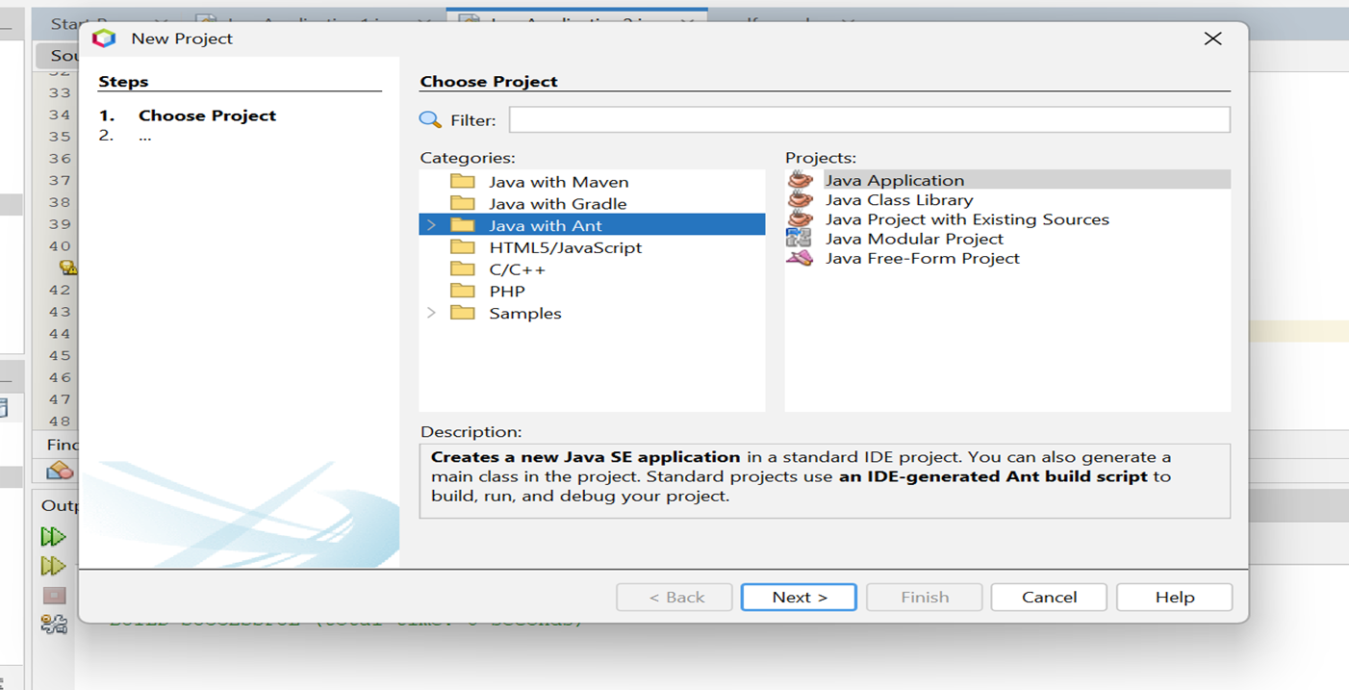
DATABASES AND APPLICATIONS
UNIT-IV- JDBC

Slide 3

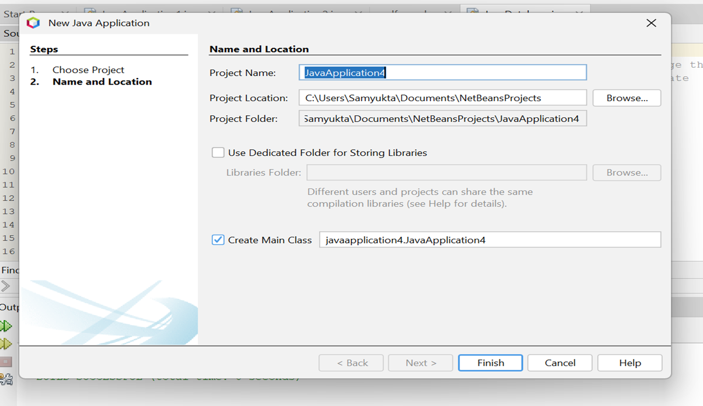
DATABASES AND APPLICATIONS
UNIT-IV- JDBC

Slide 4


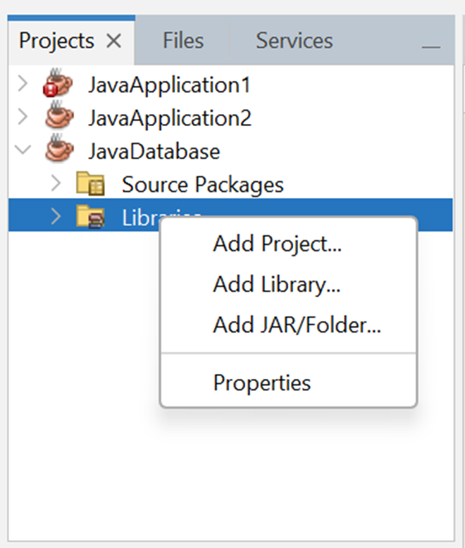
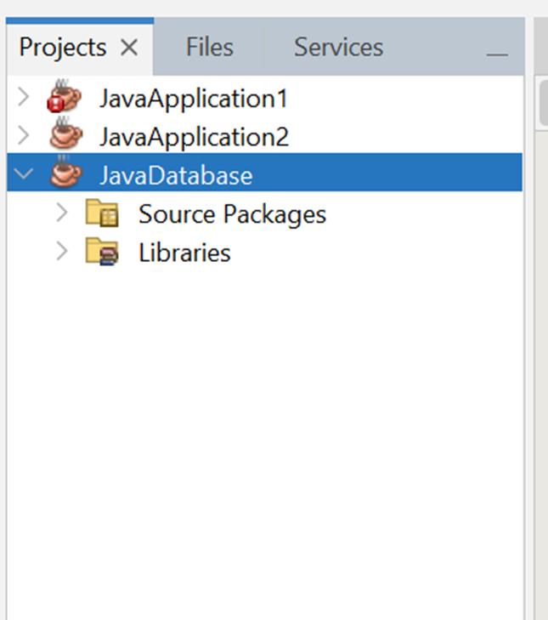
DATABASES AND APPLICATIONS
UNIT-IV- JDBC

Slide 5
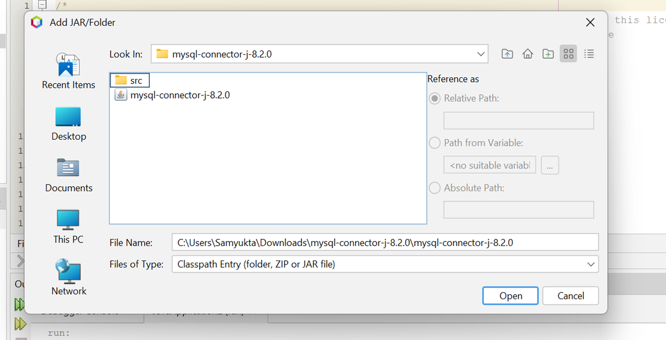
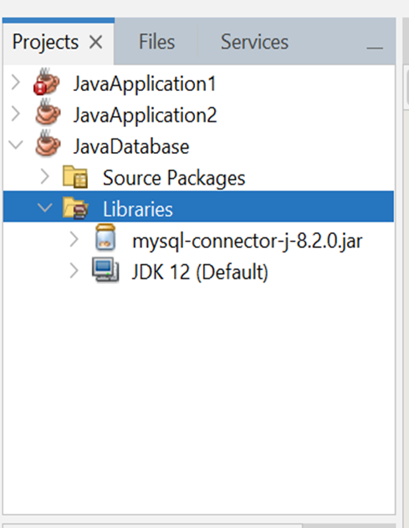
DATABASES AND APPLICATIONS
UNIT-IV- JDBC

Slide 6
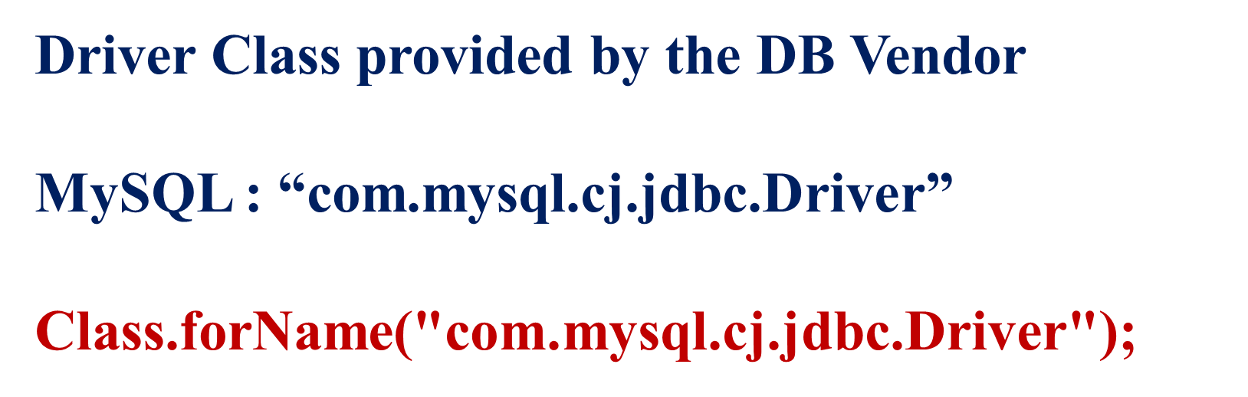
DATABASES AND APPLICATIONS
UNIT-IV- JDBC

Slide 7

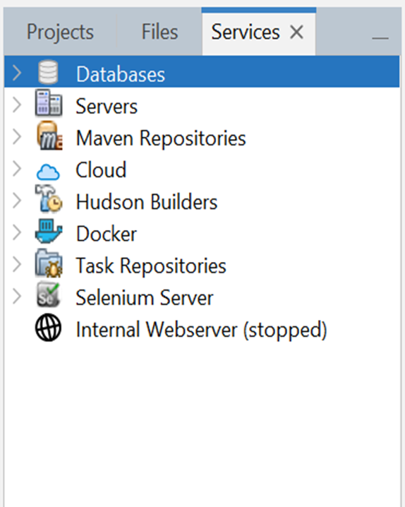
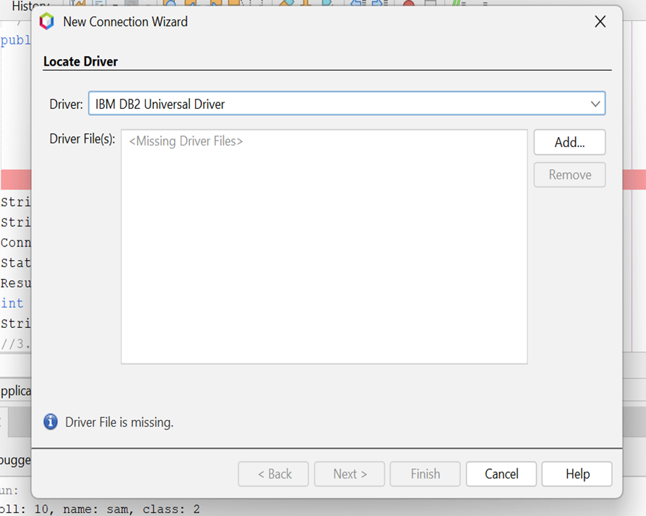
DATABASES AND APPLICATIONS
UNIT-IV- JDBC

Slide 8
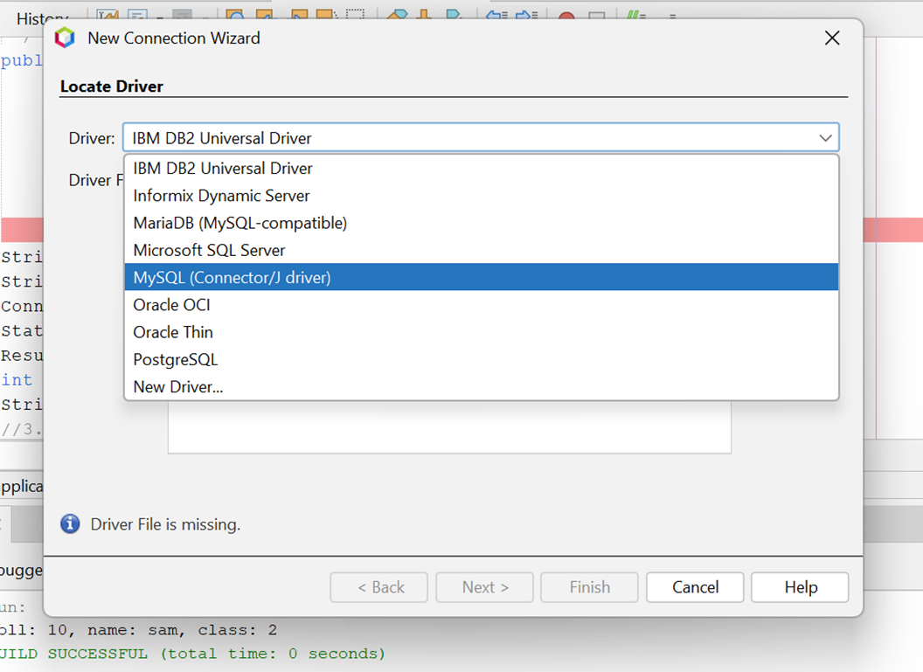
DATABASES AND APPLICATIONS
UNIT-IV- JDBC

Slide 9
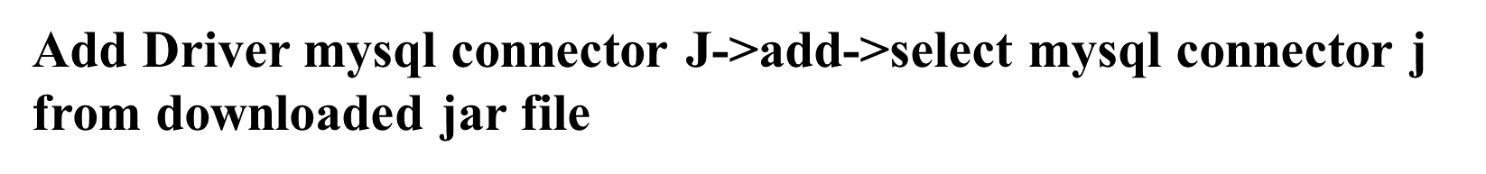
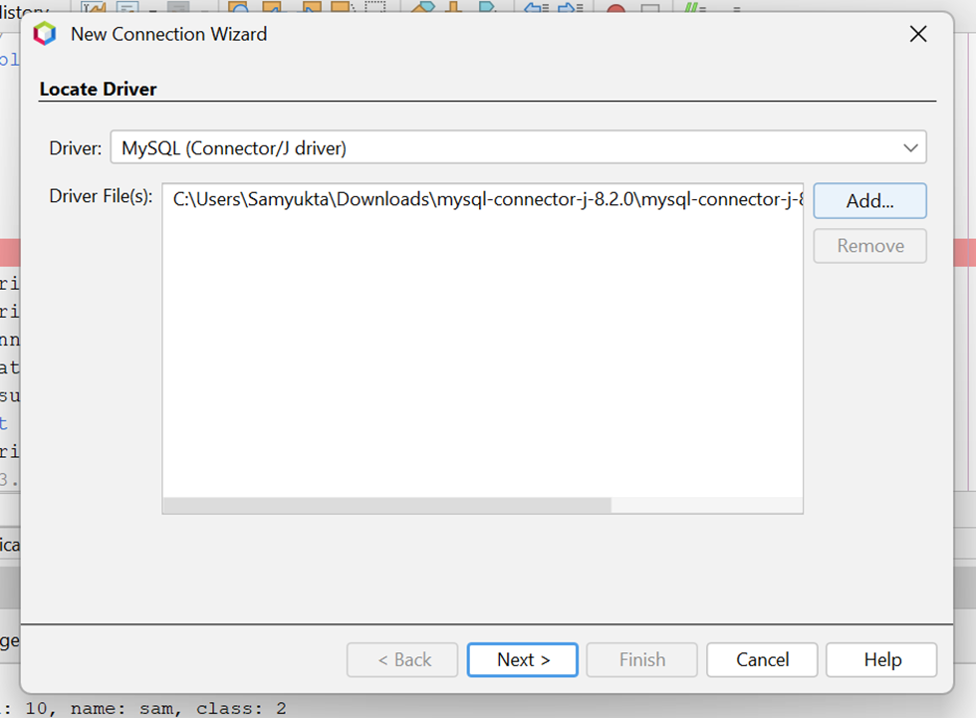
DATABASES AND APPLICATIONS
UNIT-IV- JDBC

Slide 10

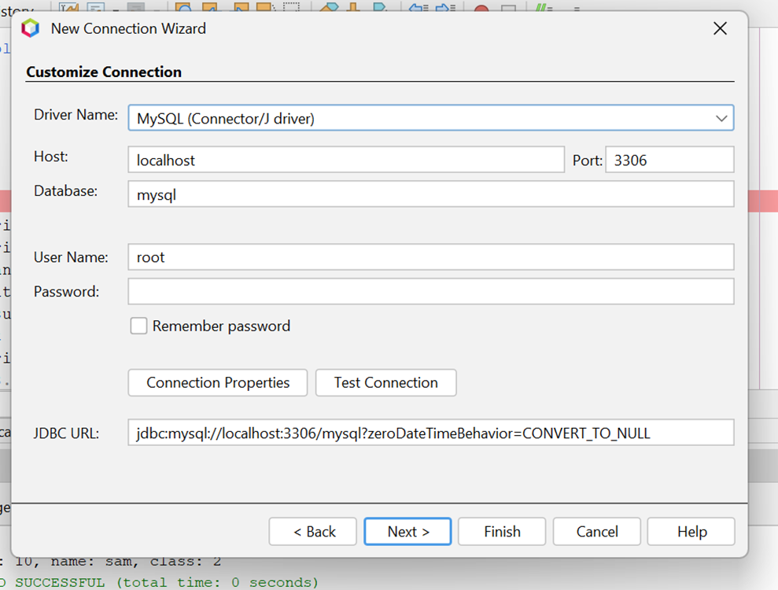
DATABASES AND APPLICATIONS
UNIT-IV- JDBC

Slide 11
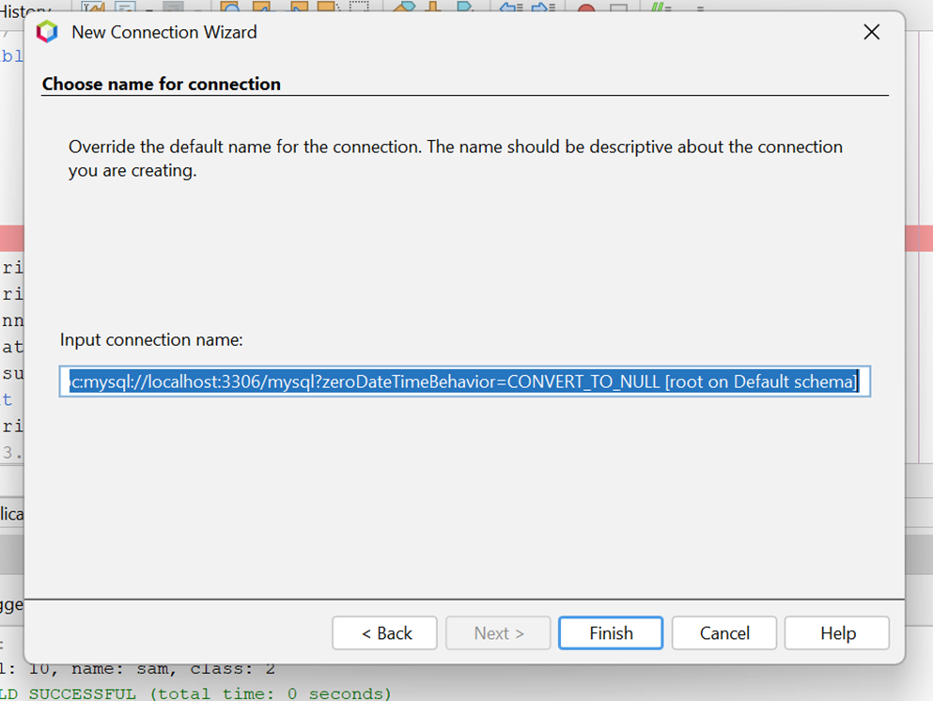
DATABASES AND APPLICATIONS
UNIT-IV- JDBC
Select input connection name -> Finish

Slide 12

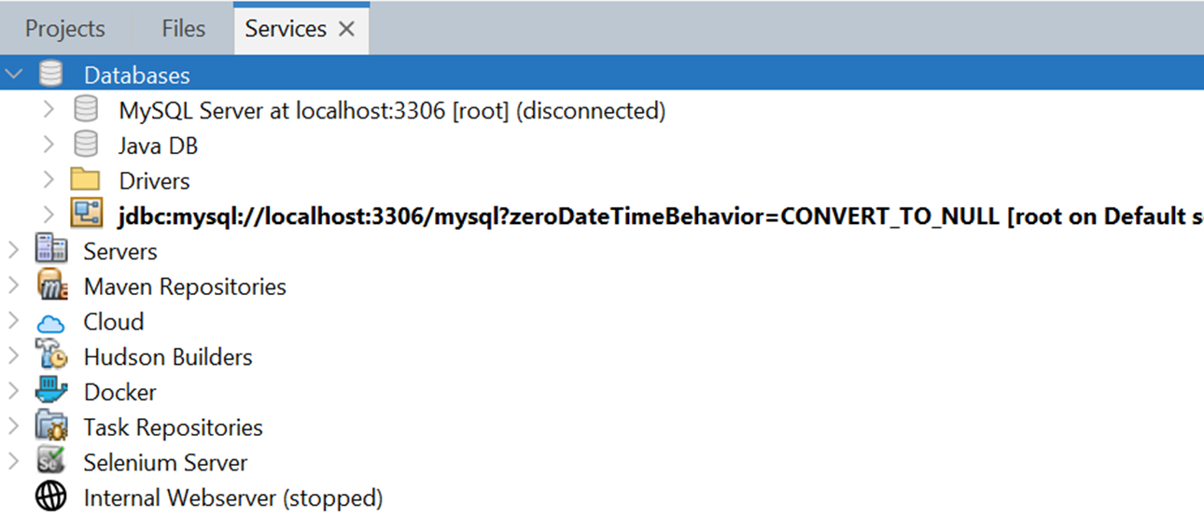
DATABASES AND APPLICATIONS
UNIT-IV- JDBC

Slide 13
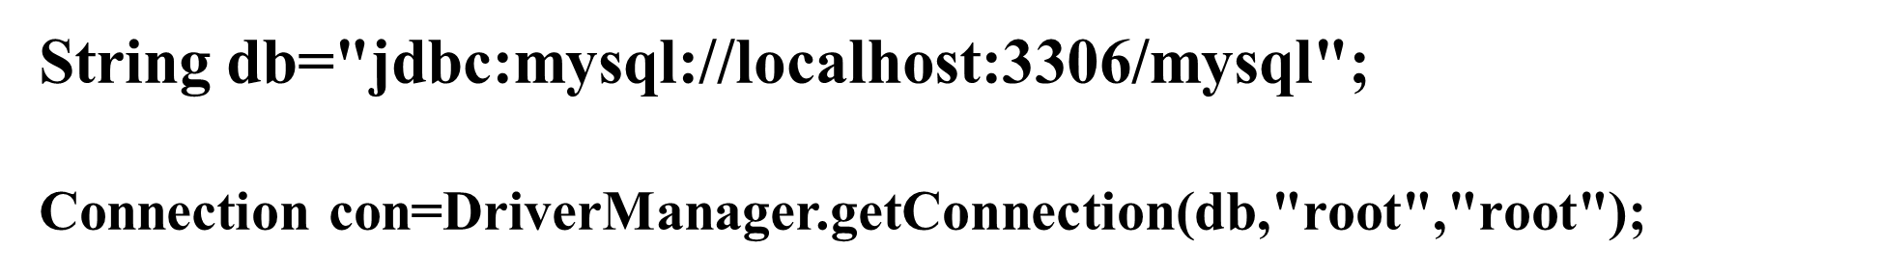
DATABASES AND APPLICATIONS
UNIT-IV- JDBC

Slide 14
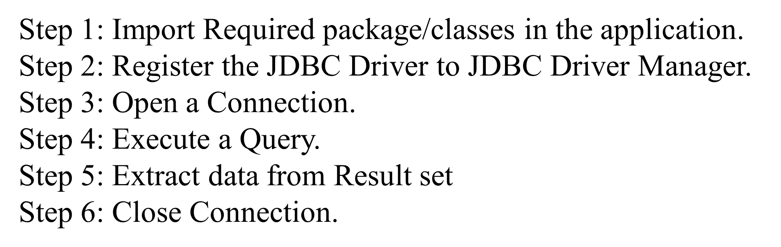
DATABASES AND APPLICATIONS
UNIT-IV- JDBC

Slide 15

THANK YOU
Samyukta D Kumta
Department of Computer Applications
samyuktad@pes.edu

